Slide 1


TO MY SPOT MAP

Slide 2

PUROKS IN POBLACION LAPUYAN,ZAMBOANGA DEL SUR
ADMIN
CONTROLLER
USER’S

Slide 3

ADMIN CONTROLLER!
GUINGHURAN GBAE
PUROK NUMBER 4
KHELAT

Slide 4
PUROKS IN POBLACION LAPUYAN,ZAMBOANGA DEL SUR
PHEGEMPUAN
KHELAT
GUINGHURAN GBAE
MALIPAYON
PUROK NUMBER 4

Slide 5



















PUROK Guinghuran gbae
LEGEND
LOMMASSON BIBLE COLLEGE
----------------- House
LAPUYAN NATIONAL
HIGH SCHOOL
----------------- Church
Purok khelat Area
----------------- School
----------------- Road
------------ River
------Basketball court
AVASMCES
LNHS road
----------------- Water Tank
-----------Existing road
Road to purok khelat
Road to purok # 4

Slide 6
ARNOLD LINGATING
WIFE: PANGINDAW HUMPA
DAUGHTER:
ARNALIE GRACE LINGATING
ARNALIE MAE LINGATING
GRANDSON:
CLARK CANILO
BACK

Slide 7
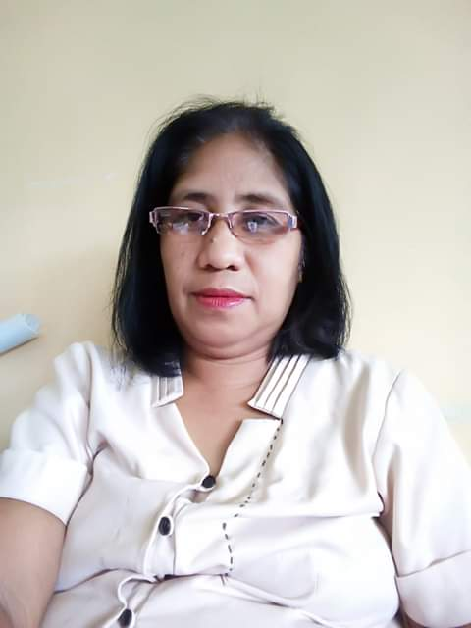
MARIBETH LUSAY
STATUS: WIDDOW
SON & DAUGHTER:
MATLUMAR JOHN LUSAY
LANIE MARIE FE LUSAY
BENZAR LUSAY
KRISTINA CIELO LUSAY
BACK

Slide 8
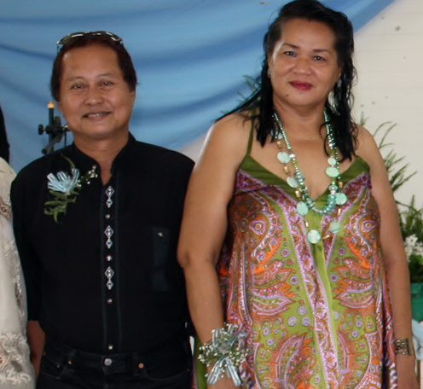
HENY LUMOSBOG
WIFE: MARILOU LUMOSBOG
SON & DAUGHTER:
MARK LOUEN LUMOSBOG
MARNELL LUMOSBOG
CHERRY MAE LUMOSBOG
JULIUS CAESAR LUMOSBOG
GRANDSON & GRAND DAUGHTER:
DWIGHT HENRY LUMOSBOG
PRINCESS AVRIL SOPHIA LUMOSBOG
CZAELL LUMOSBOG
BACK

Slide 9
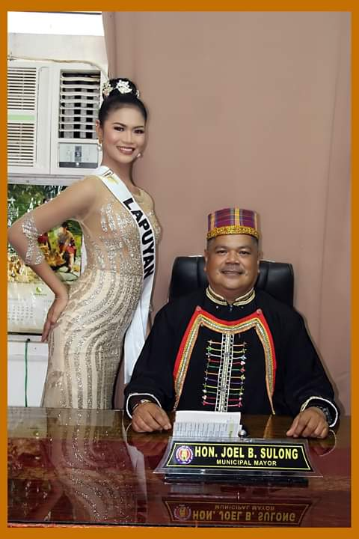
JOEL SULONG
WIFE: NELSA SULONG
SON & DAUGHTER:
QUEN RIO SULONG
SHEENA MARIE SULONG
CLEA SULONG
BACK

Slide 10
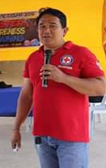
NASSRUDIN ISMAEL
WIFE:
YUMIE P. ISMAEL
DAUGHTER:
JEAN ALLYCA ISMAEL
NASSER MARK ISMAEL
BACK

Slide 11
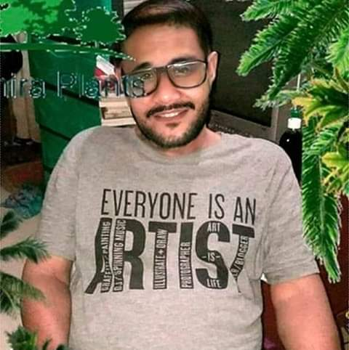
MANUEL LABADIA
WIFE: EVELYN LABADIA
SON & DAUGHTER:
DEXTER LABADIA
GERLIE LABADIA
GRANDSON:
JAIRUS LABADIA
BACK

Slide 12
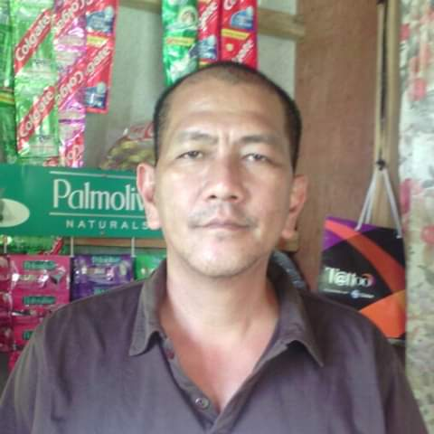
MIGUEL MANDUYAG
WIFE: RHONDA MANDUYAG
DAUGHTER:
PINKY ROSE MANDUYAG
CHARITY MAE MANDUYAG
BACK

Slide 13
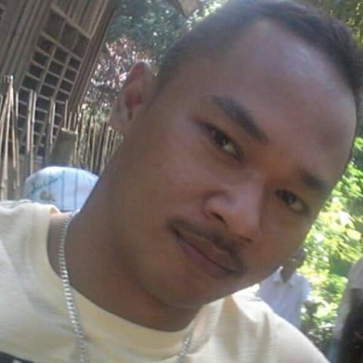
GASPAR ISMAEL
Wife: Jho Ann Esmael
SON & Daughter
Jenny mae Esmael
JUN MICHAEL SANLAO
DEXTER SANLAO
BACK

Slide 14
PERFECTO MASAL
WIFE:BRENDA MASAL
SON & DAUGHTER
ESTELLE MASAL
LORBE MASAL
ELSIELYN MASAL
CARDELINE MASAL
SHIRLY MASAL
BACK

Slide 15
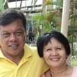
ROLAND DAGANDANG
WIFE: LILIE DAGANDANG
SON & DAUGHTER:
GLAIZA ROSE DAGANDANG
RONALD DAGANDANG
ROLLY DAGANDANG
BACK

Slide 16
CELMA MANDUYAG
STATUS: SINGLE
BACK

Slide 17
TOUS SABANG
Wife: Inday Sabang
Son & Daughter:
Marian Sabang
Marites Sabang
Lino Sabang
Leo Sabang
Melchor Sabang
Crizza mae Sabang
BACK

Slide 18
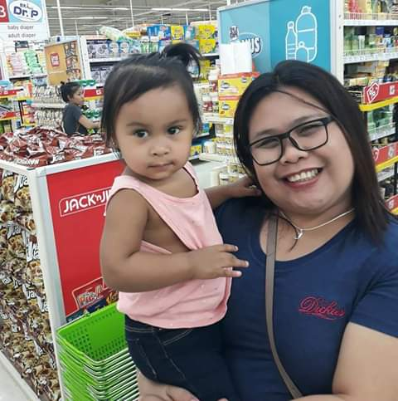
MS. JHONABEL HUMPA
STATUS: SINGLE
BROTHER AND SISTER:
JOHN MICHEL HUMPA
DAINA MARIE HUMPA
JOSEL HUMPA
BACK

Slide 19
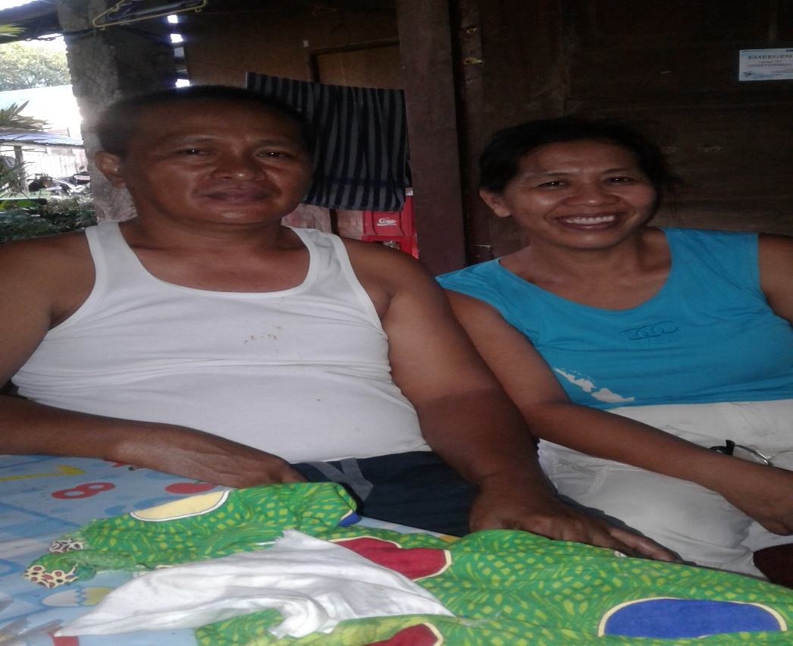
RICHARD LEA
WIFE: LILIBETH LEA
SON:
REIGH XAVIER LEA
RHYL JAISHREE LEA
DAUGTER INLAW:
JOVANIE KATE LANGASOG
GRAND DAUGHTER:
SHARA MACHINE LEA
BACK

Slide 20
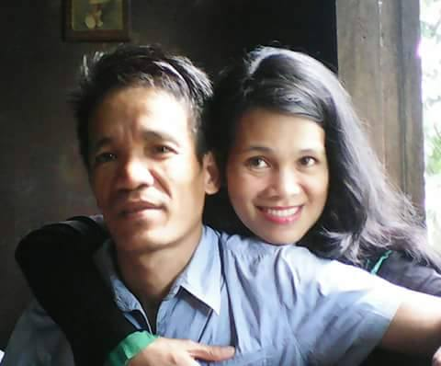
BERNIE ALTOVEROS
WIFE: MARISA ALTOVEROS
SON & DAUGHTER:
GAMALIEL ALTOVEROS
QUENZY ALTOVEROS
RIZANIE ALTOVEROS
JAMINA ALTOVEROS
BERNIE CHIN ALTOVEROS
DAUGHTER INLAW:
JESSA MAE D. ALTOVEROS
BACK

Slide 21
ROLEX LUSAY
WIFE: SERENA LUSAY
SON & DAUGHTER:
AIZA RIZ LUSAY
JELANIE LUSAY
ACE DAN LUSAY
Grand Daughter:
Zeean Alexa Orbuda
BACK

Slide 22
NARCISO ACLO
Wife: Elsiebeth Aclo
Son: Arnel Dan Aclo
Daughter In-law: Jhonette Aclo
Grand son: Ailjean jade Aclo.
BACK

Slide 23
DAVIE LANGASOG
WIFE: INDAY LANGASOG
SON & DAUGHTER:
JAYVEE FAITH GANLAG
JOVANIE KATE LANGASOG
DAVON MICHAEL LANGASOG
SON INLAW:
DARREN GANLAG
REIGH XAVIER LEA
GRAND SON & DAUGHTER:
DARVIE GANLAG
SHARA MACHINE LEA
BACK

Slide 24
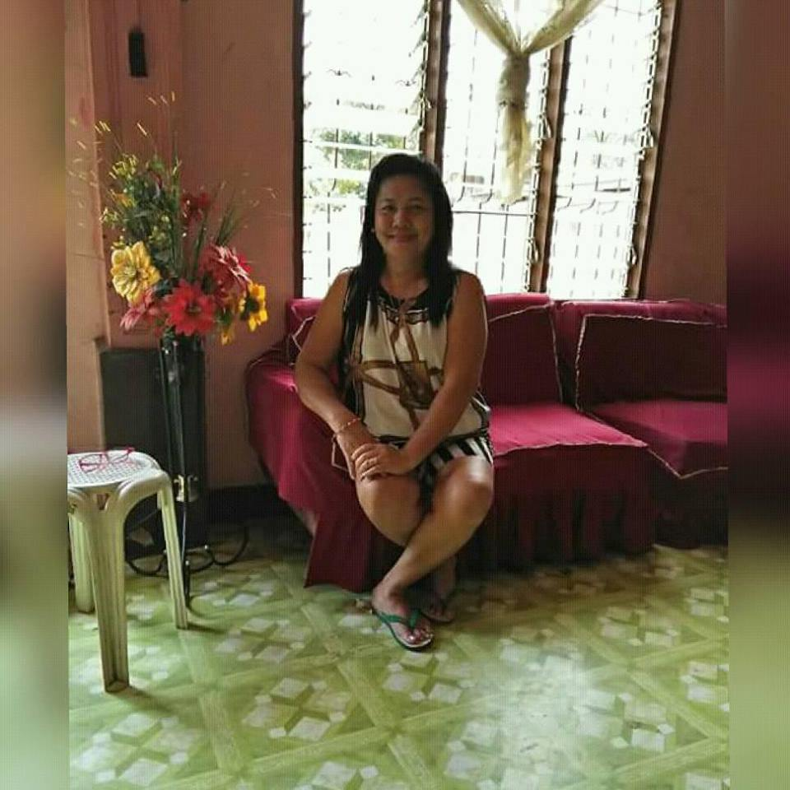
CONCEPTION G. LUSAY
Status: Widow
Son & Daughter:
Cristy Lea Lusay
Archie Lusay
Jayfer Lusay
Ariel Dan Lusay
BACK

Slide 25
RAFFY GUIYA
Daughter:
April Kate Guiya
Anneth Gaine Guiya
Lyca Lea Guiya
BACK

Slide 26
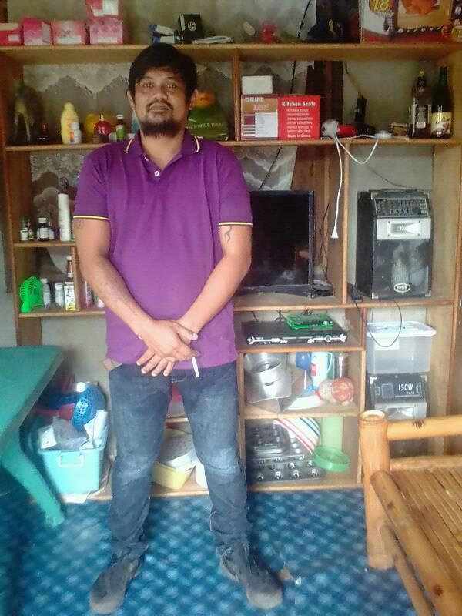
ALMER LUSAY
WIFE:
LENIE LUSAY
SON & DAUGHTER:
ALBERT LUSAY
ALLEN LUSAY
ZYRA MAE LUSAY
BACK

Slide 27
Darren Ganlag
Wife: Jevie faith Langasog Ganlag
Son: Darvie Michael Ganlag
BACK

Slide 28
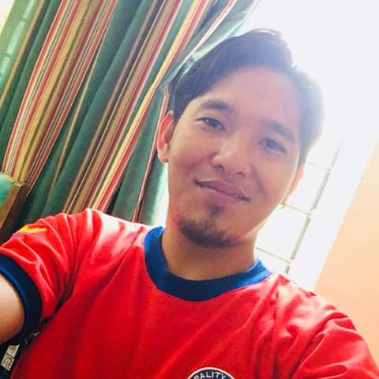
RANDY IMBING
WIFE:
ELEZABETH IMBING
SON & DAUGHTER
Allysa mae Imbing
Randy James Imbing
BACK

Slide 29
RICARDO IMBING
WIFE: JOSIE IMBING
SON & DAUGHTER:
BRIX CLIFFORD IMBING
IVAN REY IMBING
MARJORIE IMBING
RIDGE JARMAINE
BACK

Slide 30
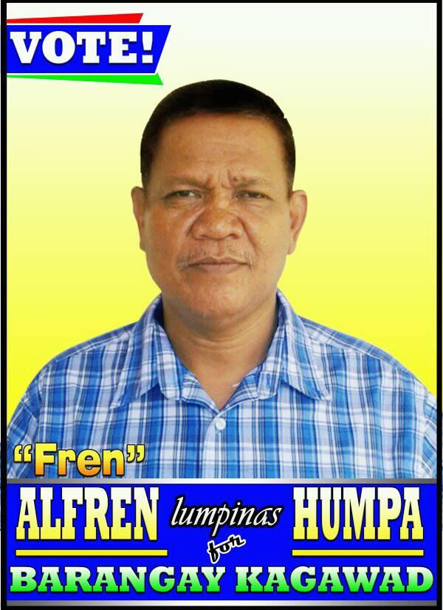
ALFREN HUMPA
WIFE: VILMA HUMPA
DAUGTER:
ALTHEA PEARL HUMPA
SON INLAW:
ARMAN RUBEN
GRAN CHILDREN:
YRL MICHAEL RUBEN
BACK

Slide 31
SAMSON TEUS
WIFE: INDAY TEUS
SON:
JASON TEUS
JEMARSON ANTHONY TEUS
BACK

Slide 32
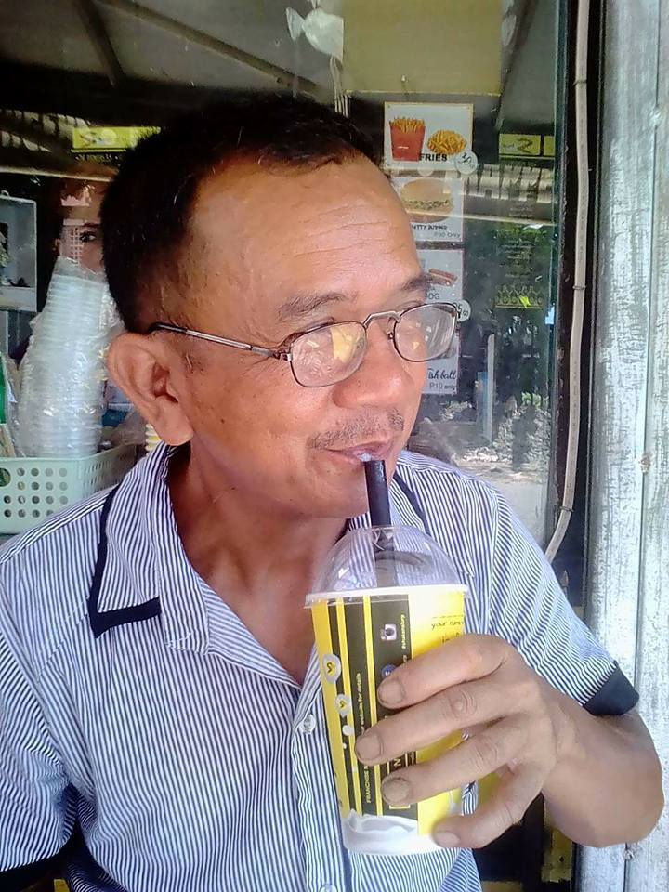
CYRUS HUMINIS
WIFE: SUSAN HUMINIS
DAUGHTER:
CRYLLE HUMINIS SIMPIN
HAZELL MAY HUMINIS
SON INLAW:
JEFFERSON SIMPIN
BACK

Slide 33
MARK HUMINIS
WIFE: MARIA HUMINIS
SON:
MARK CYRUS HIMINIS
GRAND DAUGHTER:
IRISH MARIA HUMINIS
BACK

Slide 34
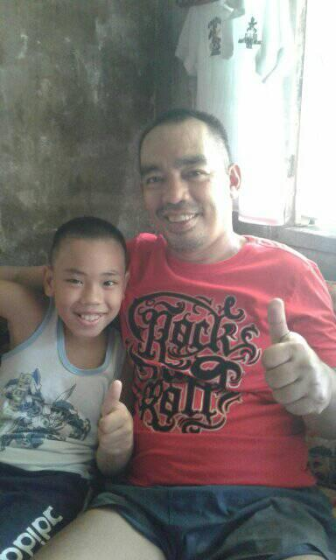
LARRY BOY DADAN
Wife: Jade Lana Dadan
Son & Daughter:
Vanie Jane Dadan
Jade Aira Dadan
Biboy Anthony Dadan
BACK

Slide 35
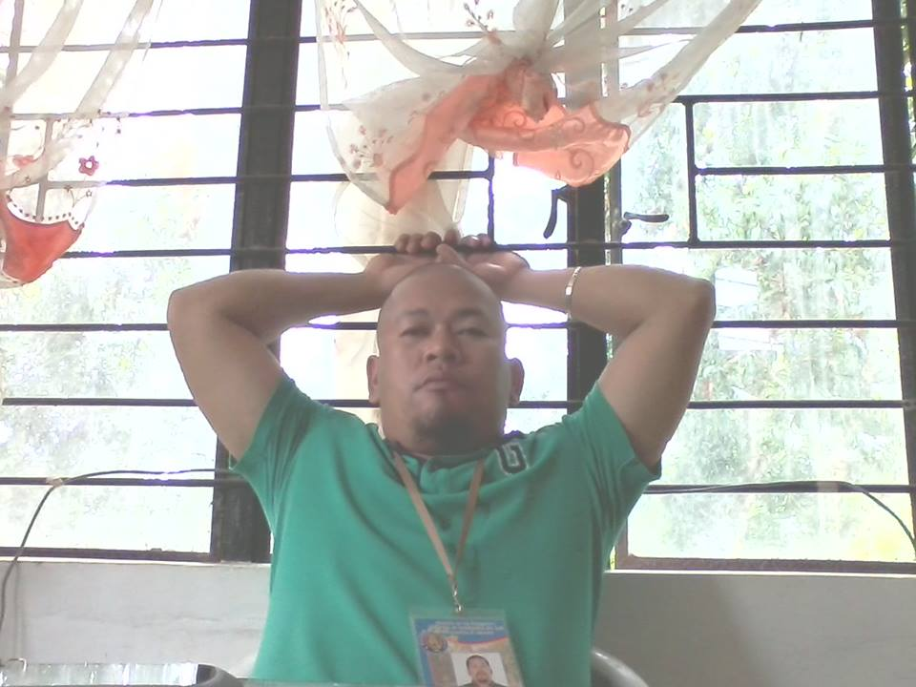
RICHIE LUSAY
Wife:
Son:
Chian Richie Lusay
Chion Andre Lusay
BACK

Slide 36
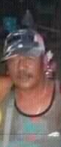
DOMINADOR SULONG
Wife: Nora Sulong
Son & Daughter:
Candice Norain Sulong
Daphnie Katherine Sulong
Dana Marie Sulong
Dominador Sulong
Dominic Sulong
BACK

Slide 37
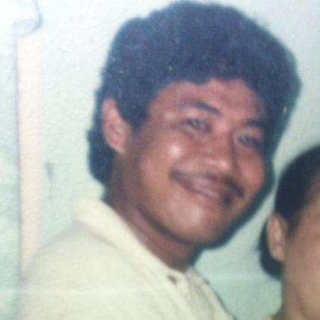
TOTO OBEDENCIO
Wife: LEONITA OBEDENCIO
Daughter: Jhonnete Aclo
Son In-law: Arnel Dan Aclo
Grandson: Ailjane Aclo
BACK

Slide 38
MOSES TENORIO
Wife: Isabel Tenorio
Son & Daughter:
Bulantoy Tenorio
Mary joy Tenorio
Langing Tenorio
BACK

Slide 39
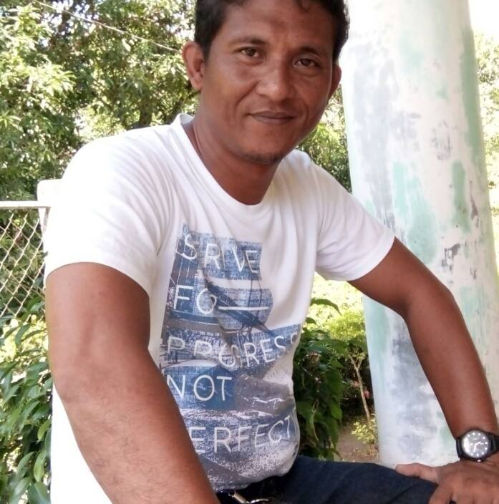
JOEL BADIANGO
BACK

Slide 40
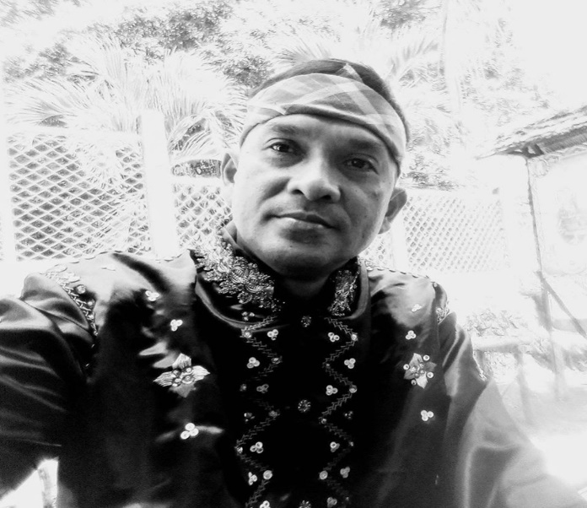
JUNILOY LINGATING
Wife: Dolly Lingating
Son & Daughter:
Kerwin Jid Lingating
Jasper brayant Lingating
BACK

Slide 41
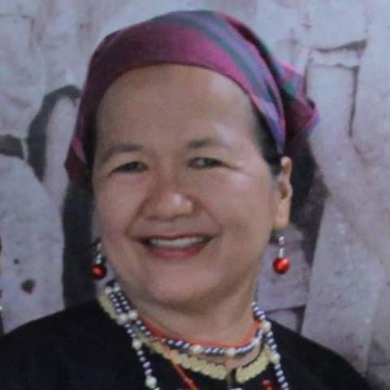
MERIAM TECSON
STATUS: SINGLE PARENT
SON & DAUGHTER
HOWARD TECSON
HOMER STEVE TECSON
MAUREEN TECSON
GRANDSON:
SETH MICHAEL ANGELO TECSON
BACK

Slide 42
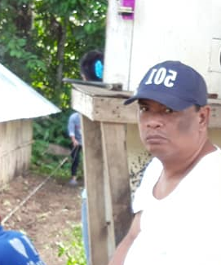
FILAMER BANGHULOT
STATUS: SINGLE
BACK

Slide 43
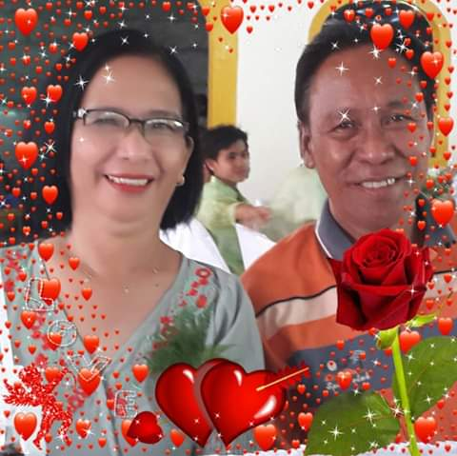
Ceasar Cris Tumanda
Wife: Lilibeth Tumanda
Son & Daughter :
Guiller Romncris Tumanda
Czarmecris Lee Tumanda
Nino Tumanda
BACK

Slide 44
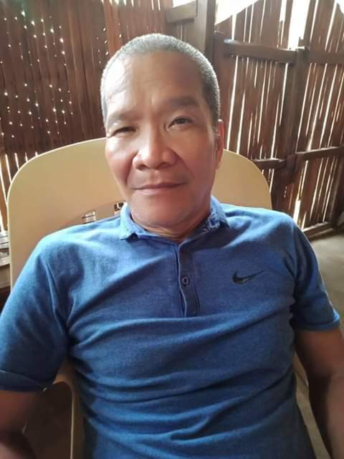
PHILIP MANGHAY
WIFE:
CHERLY MANGHAY
SON & DAUGHTER:
GEMINI MANGHAY
JOHN PHILIP MANGHAY
SON INLAW:
ELIAKIM SUMINLAO
BACK

Slide 45
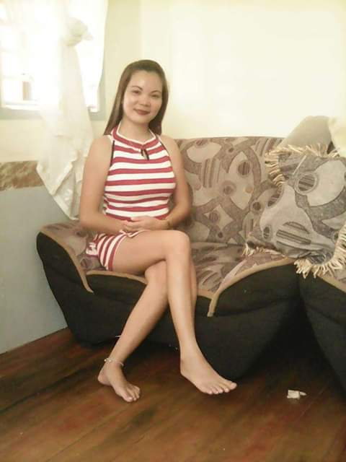
SHERYL LUSAY
STATUS: SINGLE MOM
SON & DAUGHTER:
VINCE ARON LUSAY
SHEILA MAE LUSAY
BACK

Slide 46
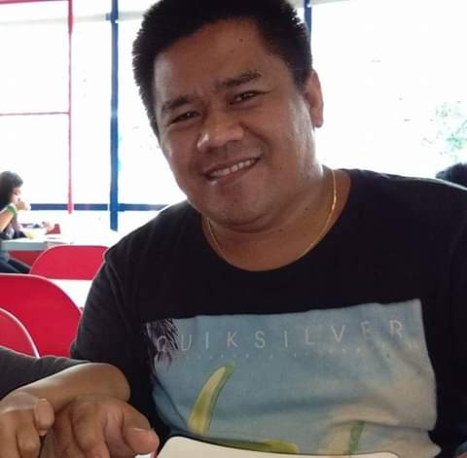
ROLDAN TIDAO
WIFE: MARIE GRACE TIDAO
SON & DAUGHTER:
LANCE GABRIEL
MARIE GABRIEL TIDAO
BACK

Slide 47
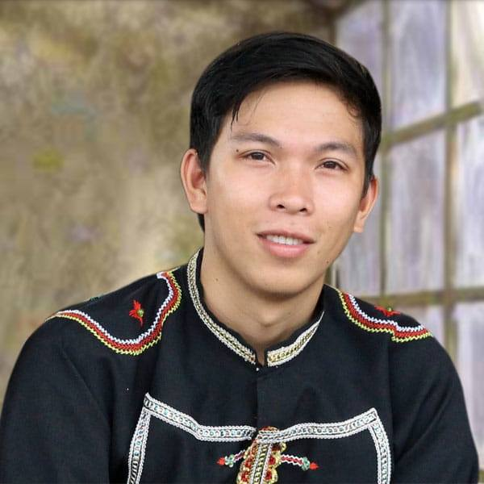
ELIAKEM SUMILNLAO
WIFE: GEMINI SUMILNLAO
DAUGHTER: GEMMA SUMINLAO

Slide 48
PUROK GUINGHURAN GBAE HOUSEHOLD LEADER!
ARNOLD LINGATING
CELMA MANDUYAG
ALMER LUSAY
DOMINADOR SULONG
MARIBETH LUSAY
TOUS SABANG
Darren Ganlag
TOTO OBEDENCIO
HENY LUMOSBOG
MS. JHONABEL HUMPA
RANDY IMBING
MOSES TENORIO
RICARDO IMBING
JOEL BADIANGO
JOEL SULONG
RICHARD LEA
BERNIE ALTOVEROS
ALFREN HUMPA
JUNILOY LINGATING
NASSRUDIN ISMAEL
MANUEL LABADIA
ROLEX LUSAY
SAMSON TEUS
MERIAM TECSON
MIGUEL MANDUYAG
NARCISO ACLO
CYRUS HUMINIS
FILAMER BANGHULOT
DAVIE LANGASOG
MARK HUMINIS
Ceasar Cris Tumanda
GASPAR ISMAEL
PERFECTO MASAL
CONCEPTION G. LUSAY
LARRY BOY DADAN
PHILIP MANGHAY
ROLAND DAGANDANG
RAFFY GUIYA
RICHIE LUSAY
SHERYL LUSAY
ROLDAN TIDAO

Slide 62
















PUROK KHELAT AREA
LEGEND
EXISTING ROAD
LAPUYAN NATIONAL HIGHSCHOOL
SCHOOL
LOMMASSON BIBLE COLLEGE
CHURCH
HOUSE
TOWER
GLOBE
RIVER
MDRRMC
RURAL HEALTH UNIT
RICE FIELD
SMART
JHCSC LAPUYAN CAMPUS
PUROK GUINGHURAN GBAE AREA
RURAL HEALTH UNIT

Slide 63
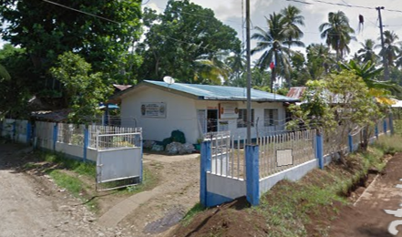
MDRRMC-LAPUYAN OFFICE

Slide 64
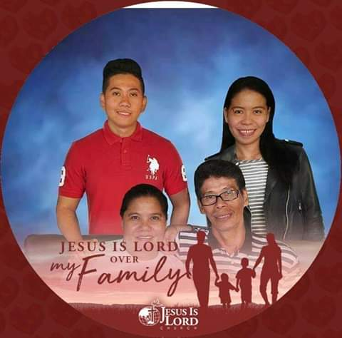
ROGER LUBATON
WIFE: SERENA LUSAY
SON & DAUGHTER:
Mark john Lubaton
Honey Marie Lubaton
BACK TO THE MAP

Slide 65
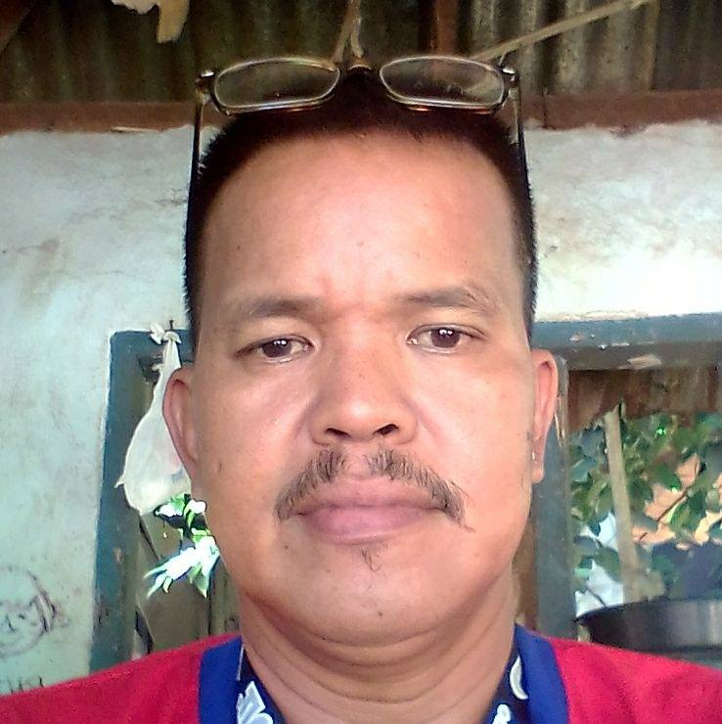
JERAB I. LAMPAYAN
BACK TO THE MAP

Slide 66
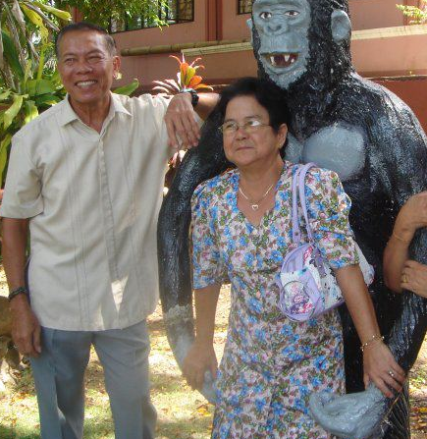
KELLY RACHELLE DAWANG
BACK TO THE MAP

Slide 67
ADUNAY DUQUE
Status: Widdow
Son: Offord Michael Duque
BACK TO THE MAP

Slide 68
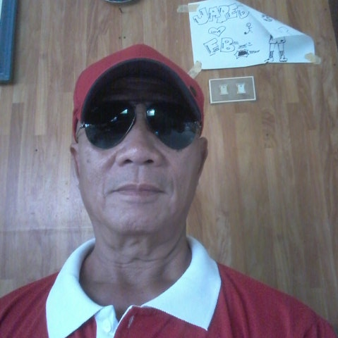
EDITO DAG
Wife: Delia D. Dag
Son: Jayred tyron Dag
BACK TO THE MAP

Slide 69
ARNULFO TEUS
WIFE: BERGIE TEUS
Son & Daughter:
Vernulfo Teus
Twingkle Teus
Arnoldfo Teus
Arnulfo Teus JR.
BACK TO THE MAP

Slide 70
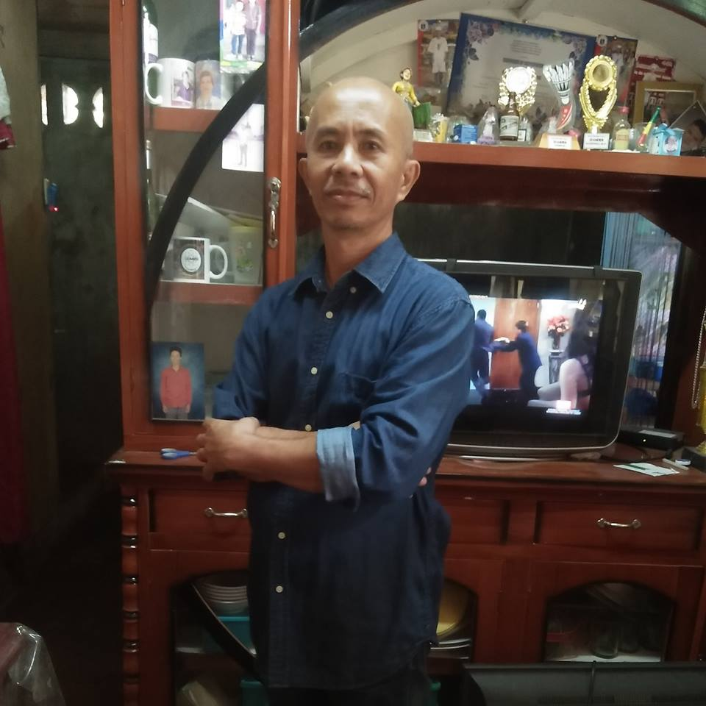
ELBUEN SINGUE
WIFE: BERGIE TEUS
Son :
ELZEND E. SINGUE
ELZON E. SINGUE
ELIAZAR E. SINGUE
BACK TO THE MAP

Slide 71
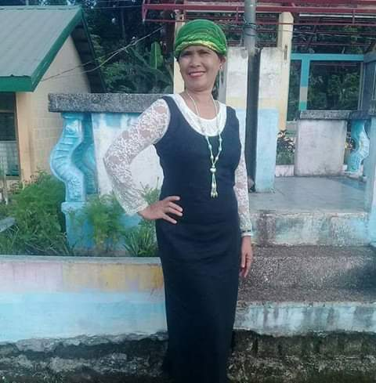
LOIDA LINGATIG
Status: Widow
Son & Daughter:
Roselleh Lingating
Gemson Mark Lingating
BACK TO THE MAP

Slide 72
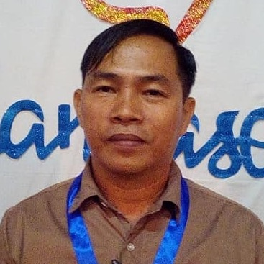
EDWARD ENTERINA
WIFE: Annie Mae Entirina
Son :
Adrian Enterina
Andrey Enterina
BACK TO THE MAP

Slide 73
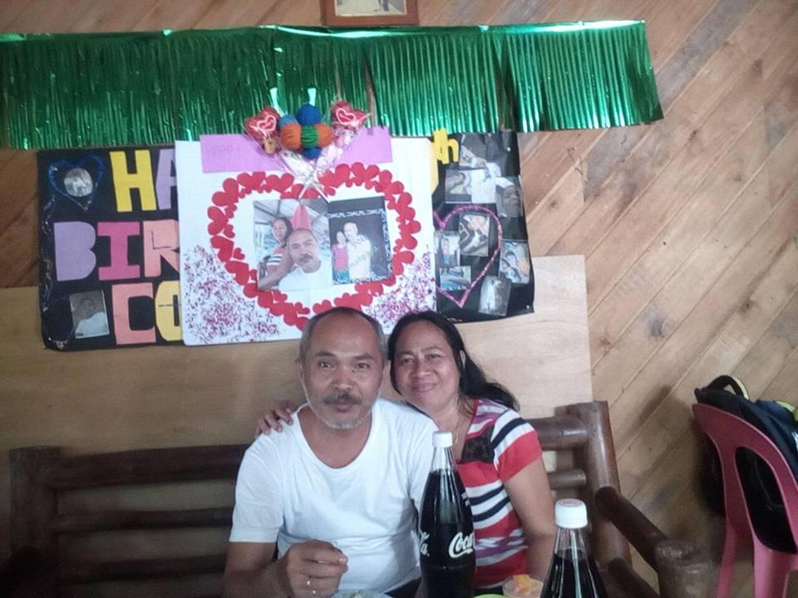
ROLANDO CABURNAY
WIFE: EMELDA CABURNAY
Son & Daughter:
CODY CABURNAY
JELANIE CABURNAY
CARDO CABURNAY
BACK TO THE MAP

Slide 74
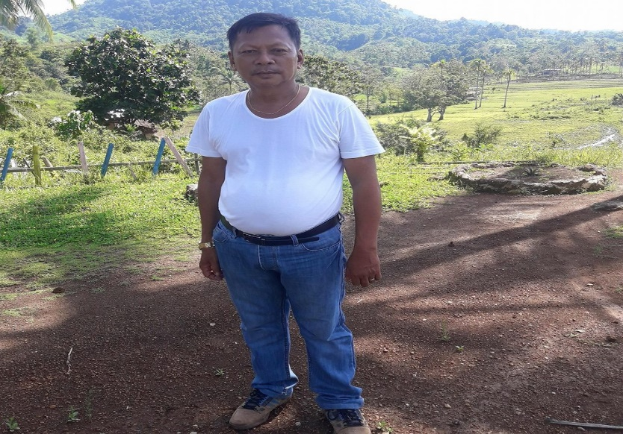
RENIEL HUMINIS
WIFE: ANGELYN HUMINIS
Daughter:
RHEAN HUMINIS
RHEA JANE HUMINIS
NIKKIE ANN HUMINIS
BACK TO THE MAP

Slide 75
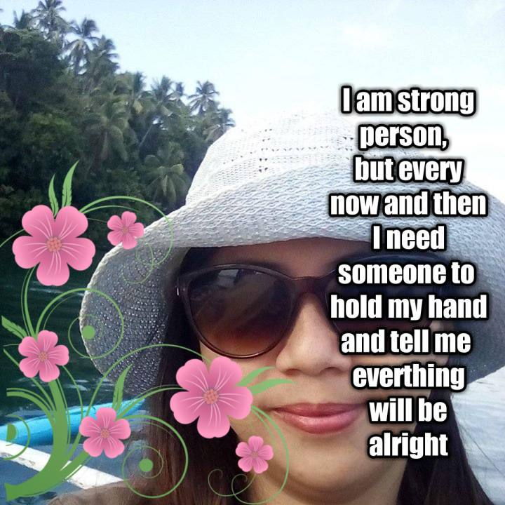
MITCH BUALAN
STATUS: SINGLE
BACK TO THE MAP

Slide 76
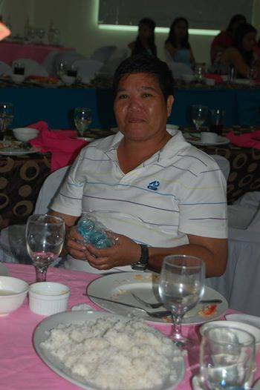
ROBERTA BELANO
STATUS: SINGLE
BACK TO THE MAP

Slide 77
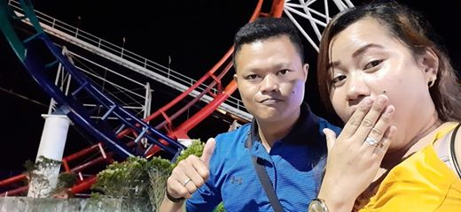
ROBERTO JAPON
WIFE: JUNILYN TUDING
STATUS: COUPLE
BACK TO THE MAP

Slide 78
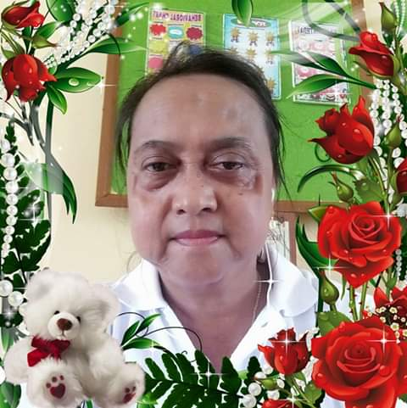
GLORY LOAYON
Status: Single Mother
Son: Prince Lowe Loayon
BACK TO THE MAP

Slide 79
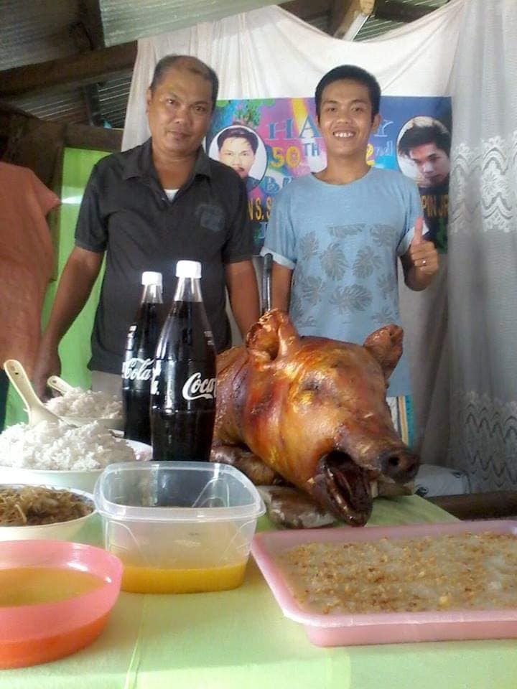
EMERSON SIMPIN
WIFE: LANIE GAY SIMPIN
Son :
JAYSON REY SIMPIN
EMERSON SIMPIN JR
RENON SIMPIN
HARVEY SIMPIN
JEFFERSON SIMPIN
BACK TO THE MAP

Slide 80
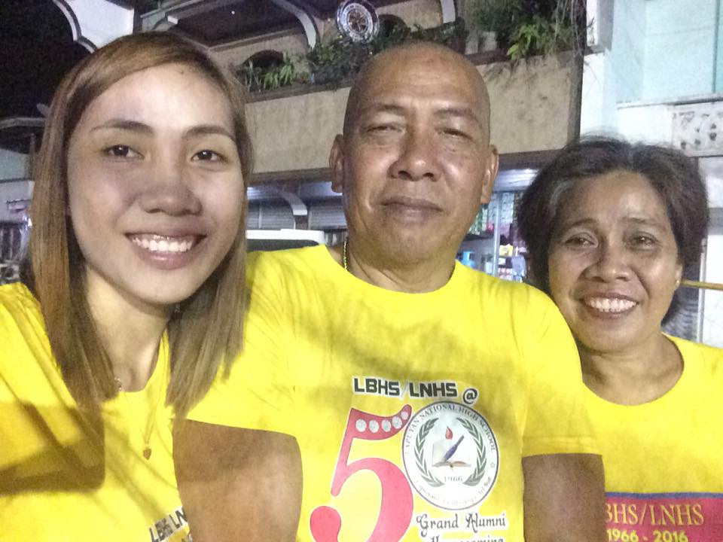
RAMILLIO GANLAG SR
WIFE: MICHELLE GANLAG
Son & Daughter:
Ramillio Ganlag JR.
Illera mae Ganlag
Ramileah Ganlag
BACK TO THE MAP

Slide 81
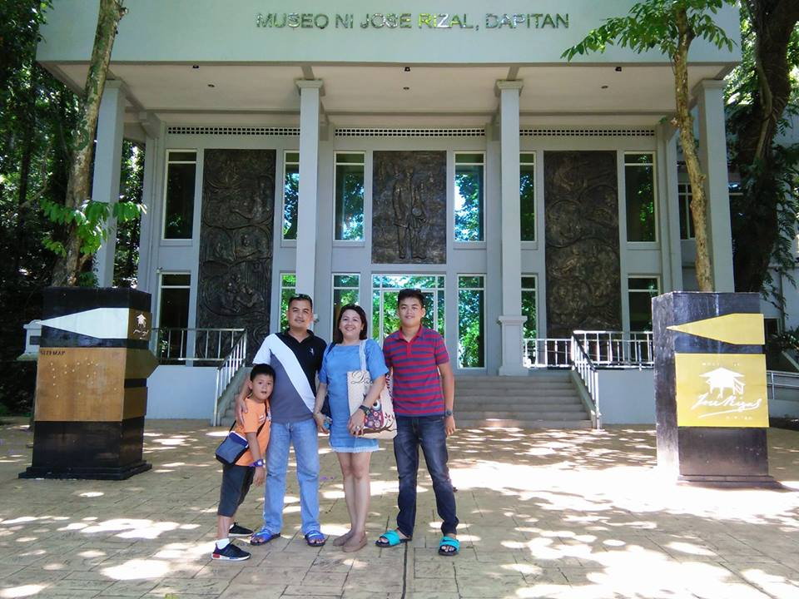
Boby Sagabaen
Wife: Gladys Gay Sagabaen
Son:
Justin Sagabaen
Blast Jasper Sagabaen
BACK TO THE MAP

Slide 82
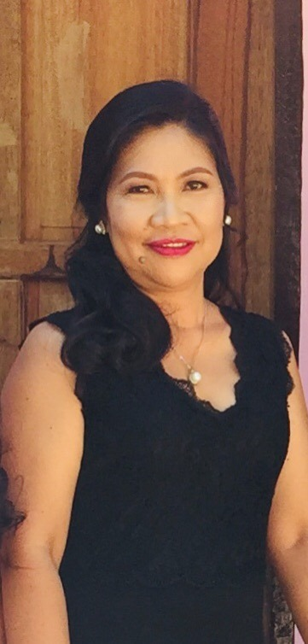
SUSAN ROSE LUBGUBAN
STATUS:WIDOW
DAUGTER:
PRECIOUSE LEE LUBGUBAN
SUZZETE ROSE LUBGUBAN
JAYDEE LUBGUBAN
BACK TO THE MAP

Slide 83
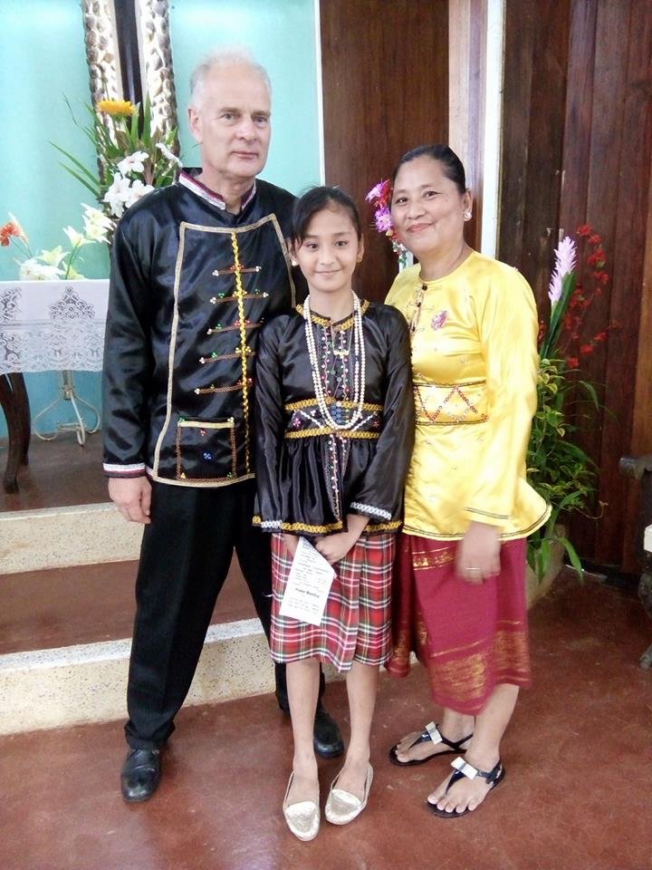
JAYSON WILLIAMS
WIFE: SALOME SALVADOR
DAUGHTER:
JASMINE SALVADOR
BACK TO THE MAP

Slide 84
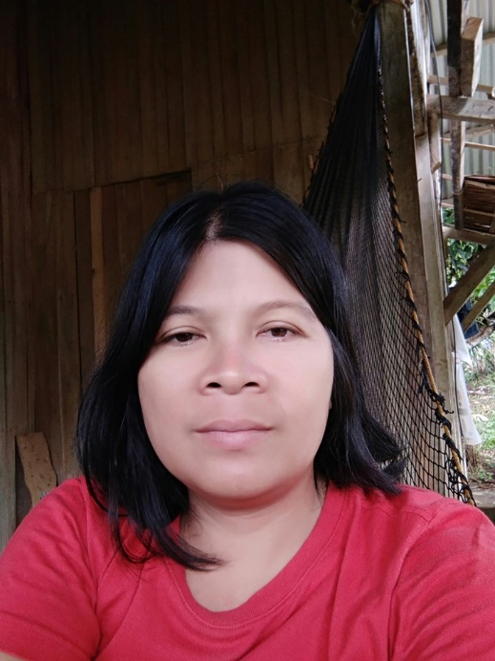
Gilbert Hatad
Wife: Josephine S. Hatad
Son & Daugter:
Gerald Hatad
Geraldine Hatad

Slide 85
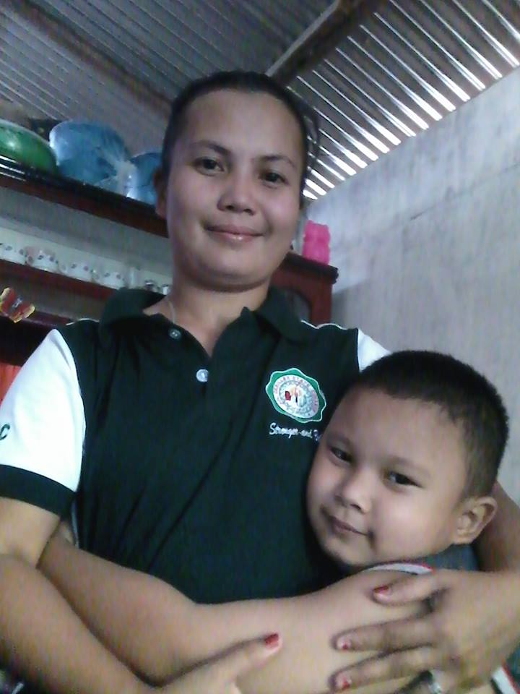
Meriam Verano
Status: Single Mother
Son: Vincent Rey Verano

Slide 86

MARLON DELACRUZ
WIFE: AILYN DELACRUZ
STATUS: COUPLE

Slide 87

RICHARD GONZALES
WIFE: MARIA JANE GONZALES
SON & DAUGHTER:
RIESEL FRANK GONZALES
RITHCHEL GONZALES
SON IN-LAW:
MAC DAVE VEGA

Slide 88

JESSY POLISCO
WIFE: VIMEN POLISCO
DAUGHTER: JAY EM

Slide 90



